Slide 2
A modern CMake's CMakeLists.txt is a collection of targets and properties. A target is a job of the building process or, in other words, a desired outcome. In our example, we want to build the source code into a binary executable: that's a target. Targets have properties: for example the source files required to compile the executable, the compiler options, the dependencies and so on. In CMake you define targets and then add the necessary properties to them.
Let's start off by creating the CMakeLists.txt file in the project directory, outside the src/ directory. The folder will look like this:
Notes:
https://www.internalpointers.com/post/modern-cmake-beginner-introduction

Slide 3
Target
Scope: private static share

Slide 4
In our current configuration we have a hardcoded preprocessor definition: USE_NEW_AUDIO_ENGINE. Why not giving users the ability to enable it optionally while invoking CMake? You can do it by adding the option() command anywhere in the CMakeLists.txt file. The syntax is the following:
option(<variable> "<help_text>" [value])
The optional [value] can be ON or OFF. If omitted, OFF is used. This is how it would look like in our dummy project:
option(USE_NEW_AUDIO_ENGINE "Enable new experimental audio engine" OFF)
To use it, just run CMake as follows:
cmake -DUSE_NEW_AUDIO_ENGINE=ON ..
or:
cmake -DUSE_NEW_AUDIO_ENGINE=OFF ..

Slide 5
Dependency Management
Find_library
Find_package
externalProject
FetchContent

Slide 6
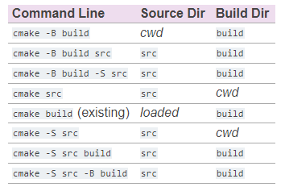
cmake [<options>] -B <path-to-build> [-S <path-to-source>]
Windows: need to specify the generator system
cmake .. –G ``MinGW Makefiles´´

Slide 7
mingw32-make
CMake
Make
.exe
https://cmake.org/cmake/help/latest/manual/cmake.1.html
https://pabloariasal.github.io/2018/02/19/its-time-to-do-cmake-right/?fbclid=IwAR0DsInbCi7rY2xTuzP48kkvvqcTlvCTMjs0sEIgtOQzNdb36_dcm_hteRw

Slide 8
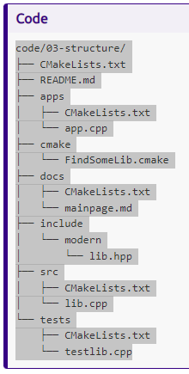
Project Structure
https://hsf-training.github.io/hsf-training-cmake-webpage/06-projectstructure/index.html

